Slide 1
Class of 2021: Junior Year Course Selections
2019-2020 School Year
Prepared by: Mrs. Antrim
Notes:
Hello Class of 2021. As we near our Course Selection Meetings scheduled the week of February 4, I want to go over important dates, an overview of the scheduling process, and provide suggestions that will help you to make the best decisions for your junior year schedule. Hopefully this presentation will cover topics and answer questions that will lead you to continue on your path of success. A copy of this ppt will be sent to your email & posted on the class website.

Slide 2
Graduation Requirements 19 total credits required for graduation Plus SAT achievement exam
Needed to graduate CCHS | # of Years/Credits | Typically required for college admittance | # of Years/Credits
English………………………… | 4.0 | English………………………… | 4.0
Math……………………………. | 3.0 | Math……………………………. | 4.0
Science………………………… | 2.0 | Science………………………… | 3.0 or more
Social Studies……………….. US History (jr.) Gov./Civics (sr.) | 2.0 | Social Studies……………….. | 3.0 or more
World Language…………… | Not required | World Language…………… | Depends on the college/university; generally 2.0 or more
Fine Arts/Vocational…… | 1.0 | Fine Arts/Vocational…….. | Depends on the college/university
Physical Education……….. | 4.0
Health…………………………. | 0.5
Consumer Education…….. | 0.5
Notes:
Included on this slide are not only the requirements for CCHS, but also the typical admission requirements for college. No matter your post-secondary path (for example, military, career, or college) you must plan ahead. It is in your junior year that you will start to see these plans come to life.
For the college-bound student, once you have a clearer picture of the colleges & universities you wish to apply, it is vital you research the specific requirements of that institution. Each college has it’s own set of requirements. If your endeavors include the military or workforce, you will want to match electives with your passions & interests.
From CCHS you must earn 19 credits to graduate, including all coursework listed on the left, above. Please make sure you have taken or will take the listed requirements.

Slide 3
Course Selection Timeline
Class Meeting (January 29, 2019)
Receive course selection sheet
Review ppt & discuss questions
Meetings with Mrs. Antrim in lab B202 (February 4-8, 2019)
We will meet during your English class and you will turn in your COMPLETED Course Selection Sheet
You will also review your requests with Mrs. Antrim & complete activities in Naviance
March – May 2019
Academic Review appointments will continue as well as reviewing requests
Contact Mrs. Antrim for any request changes BEFORE May 10, 2019
2019-2020 schedules will be released for your review & preparation at least one week before school starts.
Notes:
Today you will receive your Junior Course Selection sheet along with your course options listed on the back. Don’t worry about picking your English or math courses, I will have those recommendations from your teachers when we meet in February.
Please work to complete your Course Selection sheet by February 4. I will review your completed sheet with you during your English class some time that week, while the class independently works in Naviance.
Feel free to stop by to see me during ARP if you want to talk through your options. If you want to complete your form early & leave it with me, I would be happy to keep it for you.
If you have yet to meet with me regarding your Graduate Checklist & future plans from Q2, I will be continuing to scheduling meetings this semester.
Once all requests are in, you will have an opportunity to review your selections. Any changes to course requests will then need to be made by May 10. Your official schedule will be released for review around early August.

Slide 4
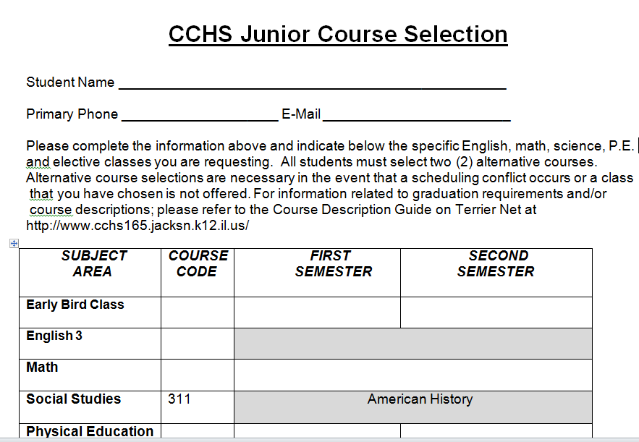
Your Options
Required Classes (3-4)
English 3 (1.0)
Math (1.0; next in the series)
U.S. History (1.0)
PE (0 to 1.0; depending on PE waiver for band or sports)
Electives (2-3)
SCIENCE (1.0; best option)
Consumer Ed. (0.5; if you haven’t taken it)
World Language (1.0)
Art, Music, Business, FCS, Industrial Tech., Health Technology, Social Studies
Alternatives (2)
You will note your top alternative classes in case of scheduling conflicts.
Notes:
As you complete your Junior Course Selection sheet, here are a few things to keep in mind. ALL juniors will be placed in English 3, Math, US History, and PE (unless you have a PE waiver).
This means you only need to pick out 2 to 3 courses. Pick a science course based on your career aspirations, use Naviance to help you make that selection. Then select your remaining electives, also based upon your career goals. You may want to also consider taking an EB course to fit more in your day, increase your interest, or develop your skills.
You will also need to select two alternate courses, these options are necessary in the event that a scheduling conflict occurs and we cannot register you for your first choice requests.
Again, I will review your completed Course Selection sheets when I meet with you during your English class in February, as well as answer any questions you may have. It is vital that you are prepared & have your sheet completed at our meeting, as it can be difficult to get through the entire class in one period. Feel free to stop by my office during ARP or lunch if you want to talk through your options.

Slide 5
Honors Information & General Course Sequences
IAG 2
IAG 3
Geometry
Algebra 2 or
Honors Algebra 2
Honors Algebra 2
Honors Pre-Calculus
Science
Select your class, ask your teacher for advice & review the course description guide for specifics on pre-requisites
PE
Team Sports, Adventure/Outdoor, Strength Training, Personal Fitness
Honors courses require an application – be sure you are meeting deadlines if you are pursuing honors placement. Talk to your teachers!
*Most deadlines have already passed.
I will have CORE course recommendations for you when we meet in February
Notes:
Here is a list of the general course sequencing in math. What to consider when you are choosing your science course, and a list of your PE options.
For Honors courses, you must have completed the application by the expected deadline; see your subject-area teacher if you have questions.
When we meet in February, I will know your core course recommendations and if you have been approved for an honors course.

Slide 6
Dual Credit Information
Dual Credit courses require a Registration Sheet & test scores. Be sure you meet all of the requirements by the posted deadlines or you will not be able to enroll in a Dual Credit course.
Steps to enroll in a Dual Credit Course
Indicate the course on your Course Selection Sheet
Complete the JALC Dual Credit Registration Form
Take the Accuplacer Exam at JALC or CCHS (test dates April 29 & 30, you will be given a test time)
Some Dual Credit Course Options
Ceramics
Intro to Statistics
Hon/AP Environmental Science
Art Appreciation
Music Appreciation
CNA
Medical Terminology
Electrical Trades
German 3 (or Honors German 3)
German 4 (or Honors German 4)
Spanish 3 (or Honors Spanish 3)
Spanish 4 (or Honors or AP Spanish 4)
Visit the JALC Schedule Website for Dual Enrollment course options.
A 2.25 cumulative GPA is required to take a Dual Enrollment Course.
Notes:
Dual Credit classes are classes which have been approved for both high school and college credit. These classes are taught here at CCHS. Students also have the opportunity to take Dual Enrollment classes, like Welding, Automotive and Sign Language, etc., on the JALC campus. Please review the Dual Credit/Dual Enrollment policies on page 26 of your Student Handbook and follow the “Steps to Enroll” on this slide to enroll in a Dual Credit or Dual Enrollment course. Start by requesting the course on your Course Selection sheet, and Registration Forms will be available at our Course Selection meetings. See me if you have questions about dual credit.

Slide 7
Summer Honors Institute with John A. Logan College
Students with a GPA of 3.25 and above qualify and should have received an email from Mrs. Sabens, the Dual Credit/Enrollment Coordinator, with all the necessary information.
Next steps, wait for John A. Logan to release their summer courses, then complete the Registration Form
which can be found in your email or the Counseling Main Office
Take the ACCUPLACER exam (April 29 or 30)
your Registration From must be in by April 5
you will automatically be given your test date/time
Keep in mind, you are building your COLLEGE transcript
make sure you have enough time to devote and feel prepared to do well in the course
Notes:
For those of you who qualify for summer coursework at John A. Logan college (having earned a 3.25 GPA and above) you have received an email from Mrs. Sabens, the Dual Credit/Enrollment Coordinator. The email addresses all the necessary steps to register for Summer Honors Institute. Please keep in mind you will be building your college transcript when you take these classes, make sure you have the time to commit to doing well in the class.

Slide 8
Considerations
Choose wisely; maintain balance & give yourself grace to sleep, study & maintain extra-curricular activities.
Consider completing your Consumer Education requirement this year if you haven’t already. Pick from one of the two options:
Personal Finance (includes a unit on the role of the government & economics)
Adult Living (includes a unit on relationships)
**You will create a resume in any Consumer Ed course you take**
ALL students are strongly encouraged to take a Science course junior year.
College-bound students consider taking or continuing World Language course, and/or additional Social Studies (especially if you have not taken any in high school)
Any failed required Sophomore course(s) will be built into your Junior year schedule.
Notes:
Just a few things to consider, if you haven’t completed your Consumer Education requirements (which is about 44% of our class), I encourage you to request it & get it done. You have two course options that qualify as Consumer Ed. (i.e., Personal Finance or Adult Living).
For the college bound student, you may want to consider taking or continuing World Language, an additional social studies (if you have not yet), and definitely a science class.
Remember, any required course that you fail this year will be built into your junior year schedule, and yes you will be in classes with freshman or sophomores if you don’t utilize your credit recovery options now.

Slide 9
Now that you know, what do you do next?
Ask questions – talk with your parents, Mrs. Antrim, teachers, friends and upperclassmen about your course options.
Find the classes that fit YOU. What is important to you, and what options pave the path to your future goals and plans?
When your transcript is reviewed by college admissions, military recruiters, and/or future employers does the coursework reflect your interests (elective courses), strengths (increase in GPA), and work ethic (most rigorous coursework shown)?
Notes:
One of the most important bits of information is written here. It is essential to maintain a healthy wellbeing. Please consider taking classes that fit you and your goals as well as allows for balance in your day. Strive to compliment rigor with classes you enjoy. As you work to complete your “Course Selection Sheet” talk with your parents, myself, teachers, upperclassmen, and friends about your options, interests, and post-secondary plans.
Your junior year transcript is what will be reviewed by college admissions – will your transcript reflect an accurate representation of you, your interests, your strengths, and work ethic? If not, start now, 2nd semester of your sophomore year to create the document that accurately reflects who you are and who you want to be.

Slide 10
Helpful Resources
Course Description Guide
Includes a brief description of each class, pre-requisites, and additional course information.
To visit the 2019-2020 CDG, click here
Class Website
Includes monthly Newsletters and important information. This presentation will be posted there, too.
To visit, click here
Naviance
Review previously submitted career assessments, saved career pathways, peruse the college tab, and review your four-year-plan.
To visit the login page, click here
Notes:
This is a slide full of resources to help you with the Course Selection process. Be mindful that some classes have pre-requisites before you can take them, you can find that information in the Course Description Guide online. Additionally, I encourage you to utilize the class website and Naviance to review your progress since freshman year, as well as your career interests and goals.

Slide 11
Closing Thoughts
Focus on...
Being your best YOU
Growing your GRIT
Asking questions
Getting involved in extracurriculars
Being familiar with the Class of 2021 Website
Signing up for the class REMIND group
Remember…
It is your 6th semester (end of junior year) transcript that is shared with colleges.
No question is off limits, no thought too silly, no dream too big.
Be checking your…
School email daily
Grades daily
Naviance weekly
Notes:
I am continuously amazed with each of you and proud of the progress you have made since the beginning of freshman year. Keep growing and strive to be your best YOU; grow your GRIT / build your work ethic; ask questions; get involved in the school community; and check your email, grades, and Naviance often!

Slide 12
Thank you!
Please have your junior course selection sheet completely filled out by February 4.
Notes:
Please have your junior Course Selection sheet completely filled out by February 4. That is it; you got this!

